Slide 1
Object-Oriented Programming
COS 1020 C++ Programming
AUBG COS Department
Based on chapter 10 – problem solving, abstraction and design using C++, Friedman & Koffman

Slide 2
Lecture Contents
10.1 Class Definition and Use
10.2 Class Implementation
10.3 Summary of Rules for Use of Classes and Objects
10.4 Classes as Operands and Arguments
10.5 A Fraction Class
10.7 A Simple String Class

Slide 3
C++ Data Types
int, float and char built-in types
Enumeration types, used for creating user-defined simple types
The string, ifstream and ofstream classes, part of the C++ standard library
OOP allows us to create user-defined types (classes) which extend the language capabilities
Can also derive new classes from existing ones - inheritance

Slide 4
Abstract Data Types
All of the data types consist of:
  Data items and
  Operations that can be performed on them
In C++ abstract data types are implemented as user-defined classes

Slide 5
The counter Class
Attributes:
  int count the counter value
  int maxValue the maximum counter value
Member Functions:
  increment increments the counter
  decrement decrements the counter
  setCount sets the counter value
  setMaxValue sets the maximum value
  getCount returns the count
  getMaxValue returns the maximum value

Slide 6
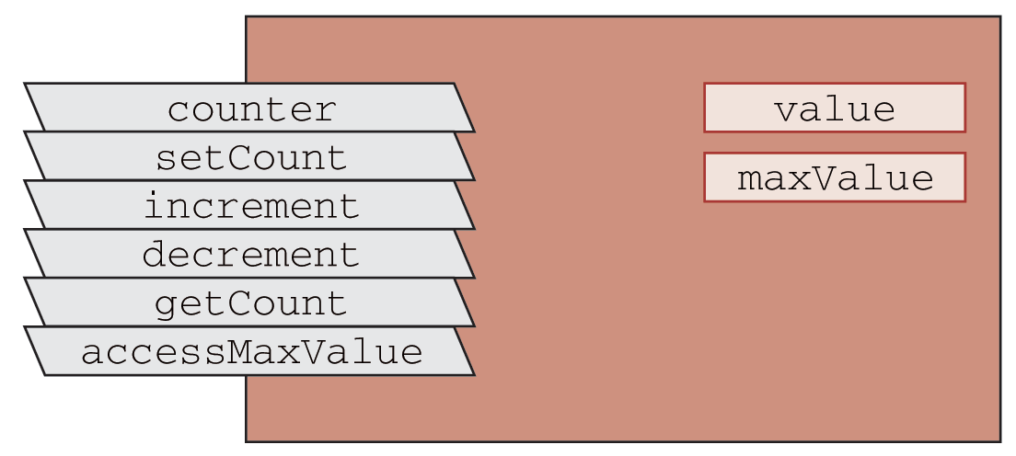
A Diagram for the counter Class

Slide 7
Class Definition
class MyClass
{
public:
// member functions and variables
private:
// hidden members like attributes, etc
}; // Note - must end with a semicolon

Slide 8
Class Definition Explained
Public section
  Specifications for variables, types, constants, and functions accessible by another program component
Private section
  Specifications for variables, types, constants, and functions to be hidden from other program components
Usually separated in a class header file (.h) – called class interface, and containing only member function prototypes

Slide 9
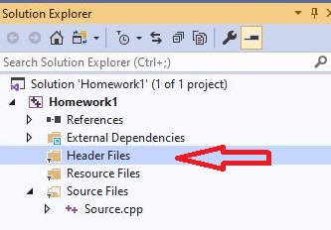
Create Header File (1)

Slide 10
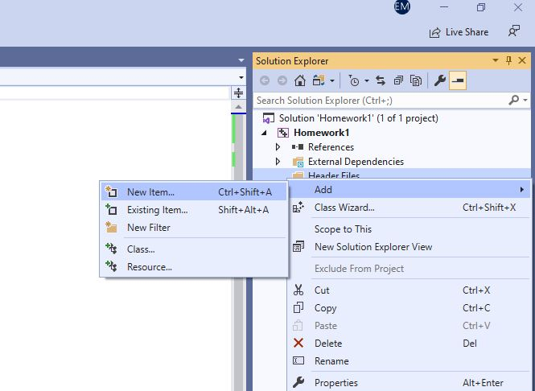
Create Header File (2)

Slide 11
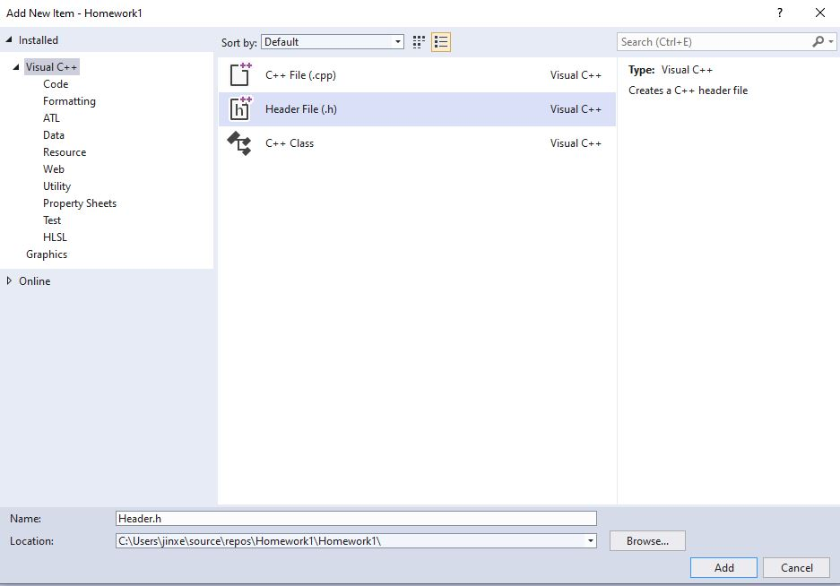
Create Header File (3)

Slide 12
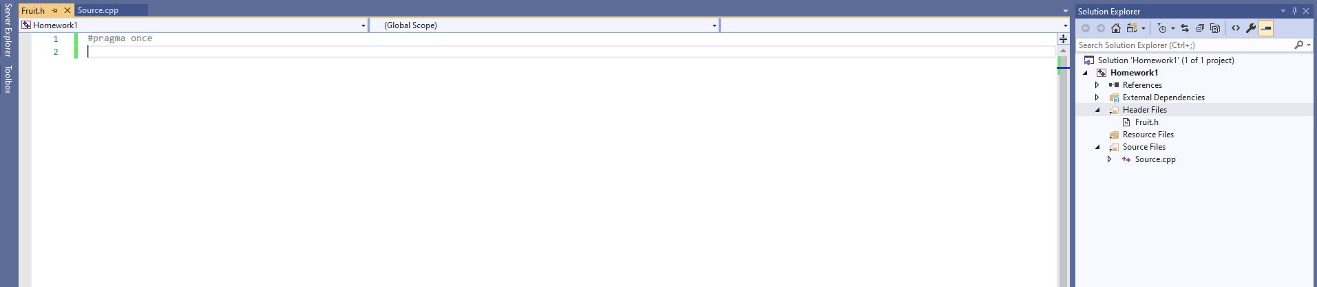
Create Header File (4)

Slide 13
counter Class Interface
#ifndef COUNTER_H
#define COUNTER_H
class Counter
{
public:
// constructors
Counter();
Counter(int);
// member functions
void increment();
void decrement();
// accessors/mutators
void setCount(int);
int getCount() const;
void setMaxValue(int);
int getMaxValue() const;
private:
// data members (attributes)
int count;
int maxValue;
};
#endif

Slide 14
Compiler Directives
The compiler directives #ifndef, #define and #endif are used to prevent multiple definitions of the class
#ifndef COUNTER_H
#define COUNTER_H
// if COUNTER_H has not been defined, the next
// line defines it and the remaining statements
// through the #endif directive are executed
#endif

Slide 15
Class Implementation
The implementation file (counter.cpp) contains the code for the class member functions
By putting those in a separate file, we hide implementation details from its users
We use the scope resolution operator :: as a prefix to each member function of the class in the implementation
The class member functions can access all data members – public and private

Slide 16
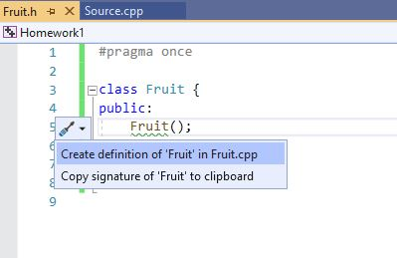
Class Implementation (continued)

Slide 17
counter Class Implementation (counter.cpp)
#include <iostream>
#include <climits>
#include "counter.h"
using namespace std;
Counter::Counter() {
count = 0;
maxValue = INT_MAX;
}
Counter::Counter(int mVal) {
count = 0;
maxValue = mVal;
}

Slide 18
counter Class Implementation (continued)
void Counter::increment() {
if (count < maxValue)
count++;
else
cerr << "Counter overflow" << endl;
}
void Counter::decrement() {
if (count > 0)
count--;
else
cerr << "Counter underflow" << endl;
}

Slide 19
counter Class Implementation (continued)
void Counter::setCount(int val)
{
if (val >= 0 && val <= maxValue)
count = val;
else
cerr << "Out of range" << endl;
}
int Counter::getCount() const
{
return count;
}

Slide 20
Constructors
Special member functions with the same name as the class and no return type
Automatically executed each time an object is created
Used for initializing the object’s data members
Default (zero-parameter) constructor:
  Counter c1;
One parameter constructor:
  Counter c2(10);

Slide 21
Accessor and Modifier Functions
Member functions which modify object data members are called modifiers (mutators)
  increment(), decrement()
  setCount(int)
Member functions that do not update the object’s state are called accessors
  getCount(), getMaxValue()
  Can contain the const keyword at the end of the header to enforce that behavior

Slide 22
Using the counter Class
To use the counter class in a program, you must include the "counter.h" header file as the class definition is contained there
#include <iostream>
#include "counter.h"
To include a header file, one must use double quotes around its name, instead of brackets (<>)

Slide 23
Example: Counter Test Program
#include <iostream>
#include "counter.h"
using namespace std;
int main()
{
Counter c1; // declare two objects of type counter
Counter c2(10); // c2 has a maximum value of 10
c1.setCount(50); // set the value of c1 to 50
c1.decrement();
cout << "c1 is: " << c1.getCount() << endl;
c2.increment();
cout << "c2 is: " << c2.getCount() << endl;
return 0;
}

Slide 24
Compiler Directives in counter.cpp
Both the implementation file (counter.cpp) and the main program file contained the line:
#include "counter.h"
This is required so the compiler can find the class definition
The #ifndef, #define and #endif in the header file prevented multiple definitions of the class
Note the inclusion of the climits library

Slide 25
Summary of Rules for
Use of Classes and Objects
Objects as class instances
  Counter c1;
  Creates an instance of the class counter
  The default (zero-parameter) constructor is invoked
  Allocates space in memory for the object
Similar to other data type declarations:
int value;
  Allocates space in memory for a data type int

Slide 26
Private vs Public Access
Public member functions are accessible from outside the class and allow users to perform operations on an object:
  E.g.: setCount, increment, decrement
Classes may have private member functions
  If member functions do not need to be used from external code, they should be private
Class attributes are usually, but not always, private
Be cautious when defining public access

Slide 27
Class Syntax
class ClassName
{
public:
List all public data and functions
private:
List all private data and functions
}; Don’t forget the semicolon

Slide 28
Member Function Definition
type ClassName::fname(formal parameter list)
{
...
Function body
...
}

Slide 29
Combining Arrays, Structs and Classes
Class data members can be of any type:
  Simple built-in types
  Arrays
  Structs
  Other class types
You can also declare an array of class objects:
  Counter counters[10];
  Note: counter should have a default constructor in order for this to work!

Slide 30
Function Overloading & Polymorphism
The counter class has two functions with the same name – the constructors
Defining multiple functions with the same name is called function overloading
The ability of a function to change its operation based on the parameters or the object it is applied to, is called polymorphism

Slide 31
Classes as Operands and Arguments
The assignment operator can be used with two objects of same type, but not other operators
  Others must be re-defined through a mechanism called operator overloading
To pass an object of class type C as parameter with name obj, use:
  C& obj – as a formal reference parameter
  const C& obj – as a constant reference formal parameter to indicate that the object cannot be modified

Slide 32
compareCounter Function
int Counter::compareCounter(const Counter& aCounter) const
{
int result;
if (count < aCounter.count)
result = -1;
else if (count == aCounter.count)
result = 0;
else
result = 1;
return result;
}

Slide 33
User-defined Types
Object-oriented programming relies on heavy usage and implementation of user-defined types – by using the class construct
UDTs are designed and developed to provide specific functionality, not implemented by built-in types
They are implemented by using built-in types and other already defined user types
Once defined, they can be used in the program for many different purposes

Slide 34
A Simple String Class
If C++ Standard Library did not provide a string class, we would have to create one
The minimum functionality we need is:
  - create a string
  - length
  - capacity
  - at
  - read and write

Slide 35
Specification for Class SimpleString
Attributes
  - capacity
  - contents
  - length
Member functions
  - SimpleString - getLength
  - readString - getCapacity
  - writeString - at

Slide 36
SimpleString Class Interface
#pragma once
class SimpleString
{
public:
SimpleString();
void readString();
void writeString() const;
char at(int) const;
int getLength() const;
int getCapacity() const;
void getContents(char[]) const;
private:
enum { capacity = 255 };
char contents[capacity];
int length;
};

Slide 37
SimpleString Class Implementation
#include <iostream>
#include "SimpleString.h"
using namespace std;
SimpleString::SimpleString()
{
length = 0;
}
void SimpleString::writeString() const
{
for (int pos = 0; pos < length; pos++)
cout << contents[pos];
}

Slide 38
SimpleString Class Implementation (continued)
void SimpleString::readString()
{
char next;
int pos = 0;
cin.get(next);
while ((next != '\n') && (pos < capacity)) {
contents[pos] = next;
pos++;
cin.get(next);
}
length = pos;
}

Slide 39
SimpleString Class Implementation (continued)
char SimpleString::at(int pos) const
{
if ((pos < 0) && (pos >= length)) {
cerr << "Character not defined" << endl;
return '\0';
}
else {
return contents[pos];
}
}

Slide 40
SimpleString Class Implementation (continued)
int SimpleString::getLength() const
{
return length;
}
int SimpleString::getCapacity() const
{
return capacity;
}
void SimpleString::getContents(char str[]) const
{
for (int i = 0; i < length; i++)
str[i] = contents[i];
}

Slide 41
Testing the SimpleString Class
SimpleString str;
cout << "Enter a string: ";
str.readString();
cout << "You entered: ";
str.writeString();
cout << endl;
// display each character on a separate line
for (int i = 0; i < str.getLength(); i++)
cout << str.at(i) << endl;

Slide 42
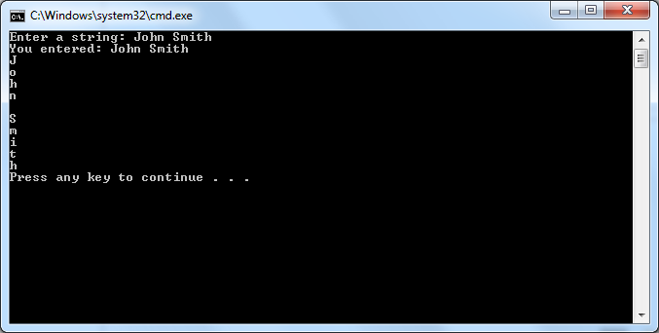
SimpleString Testing Output

Slide 43
Questions?
Q & A

